Slide 1
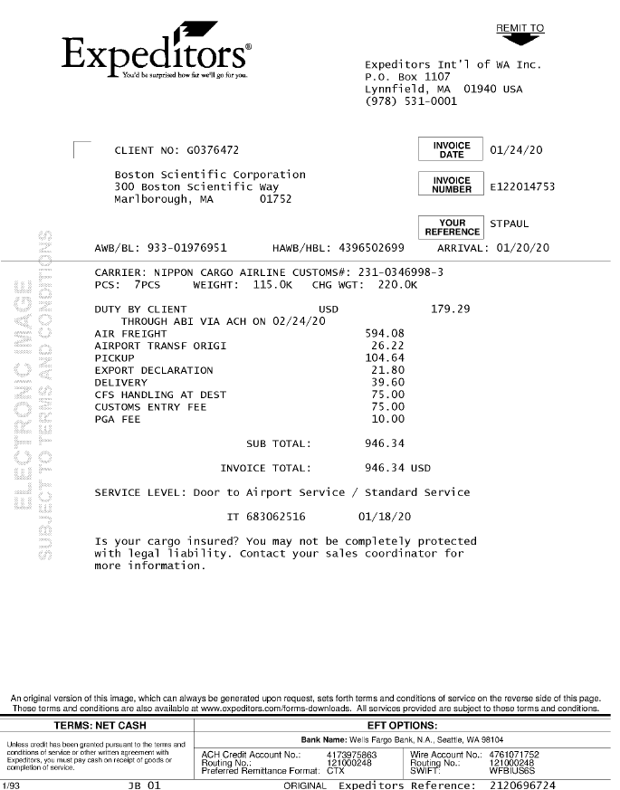
01
68a AWB
68b HAWB
01 Remit To
05 Acct
10 Inv Date
03 Inv Key
02 Bill To
62 Delivered
46 Pieces
47 Pieces UOM
42 Actual Wt
44 Actual Wt UOM
43 Fncl WT
45 Fncl WT UOM
72 Description
85 Line Item Amt
14 FB Amt
08 Inv Amt
09 Curr
38 Srvc Level
05
10
02
03
68b
62
68a
46
47
42
43
45
72
44
85
08/14
09
38
Note:
Data Entry should be able to capture from and to information (Address) from what was reflected in the commercial invoice whenever available. If not provided then use the BOL.

Slide 2
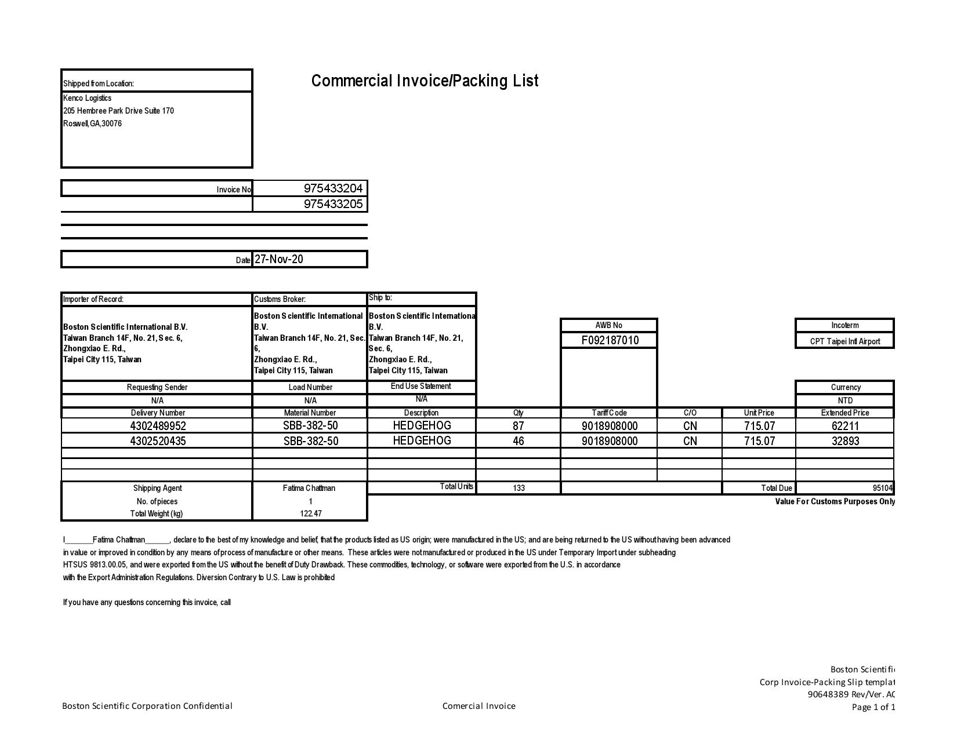
Note:
Data Entry should be able to capture from and to information (Address) from what was reflected in the commercial invoice whenever available. If not provided then use the BOL.
27
27 SHIPPER INVOICE
30 CONSIGNEE INVOICE
30

Slide 3
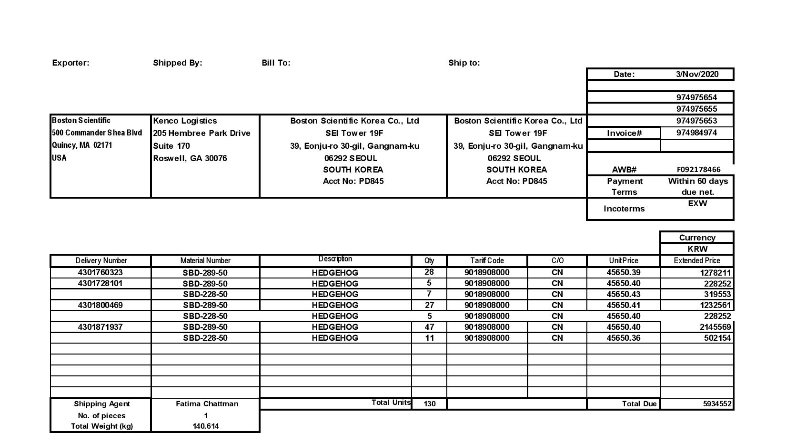
Note:
Data Entry should be able to capture from and to information (Address) from what was reflected in the commercial invoice whenever available. If not provided then use the BOL.
27
30
27 SHIPPER INVOICE
30 CONSIGNEE INVOICE

Slide 4
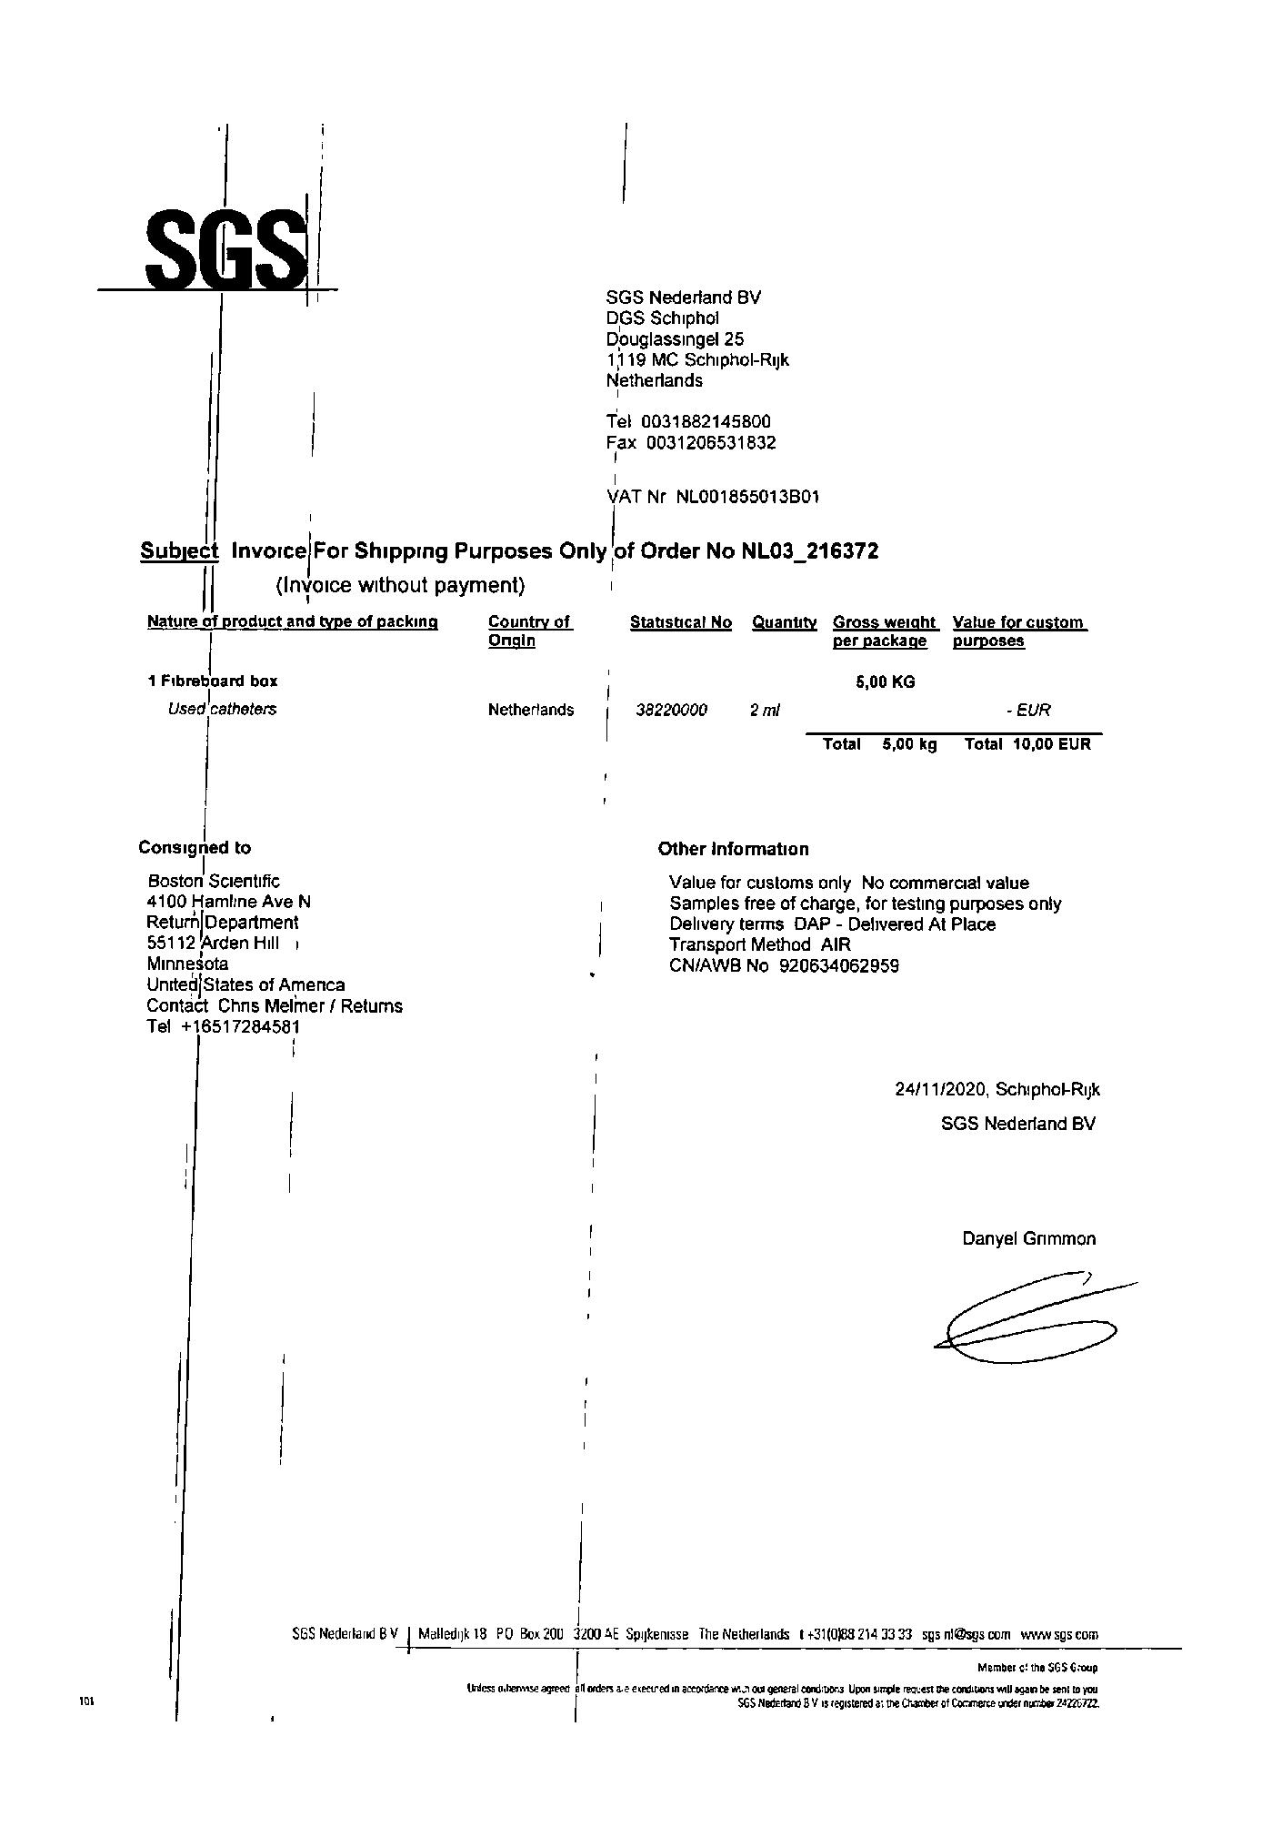
27
27 SHIPPER INVOICE
30 CONSIGNEE INVOICE
30
Note:
Data Entry should be able to capture from and to information (Address) from what was reflected in the commercial invoice whenever available. If not provided then use the BOL.

Slide 5
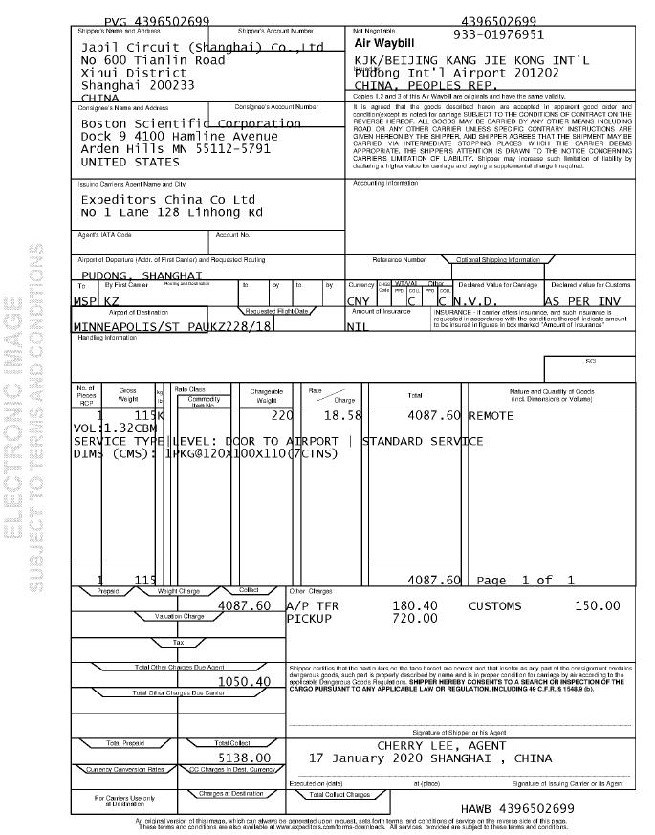
28.9
68a
28
68A HAWB
36 FREIGHT TERMS
95 PCSCNT
96 GROSSWT
98 WTUOM
97 NETWT
90 PRODDESC
100 DIM UOM
99 DIM
61 PICKUP
31 BOL CONSIGNEE
31.9 BOL CONSIGNEE PORT
28 BOL SHIPPER
28.9 BOL SHIPPER PORT
31
33
31.9(a)
36
31.9(b)
34
96
98
97
90
95
Note:
Data Entry should be able to capture from and to information (Address) from what was reflected in the commercial invoice whenever available. If not provided then use the BOL.
100
99
NOTE:
If there is no port code in 31.9a, use the port code at 31.9b. 31.9a should prevail if not empty
61

Slide 6
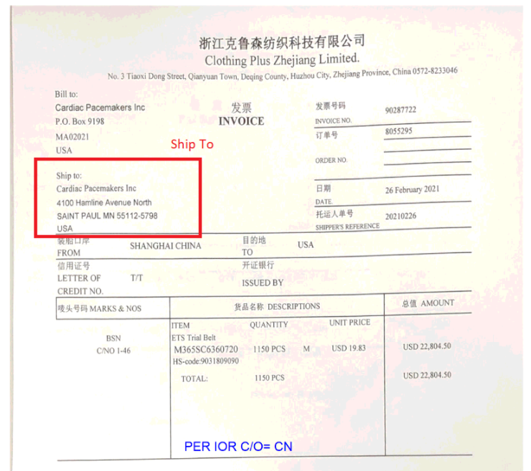
27 SHIPPER INVOICE
30 CONSIGNEE INVOICE
27
30
Note:
Data Entry should be able to capture from and to information (Address) from what was reflected in the commercial invoice whenever available. If not provided then use the BOL.

Slide 7
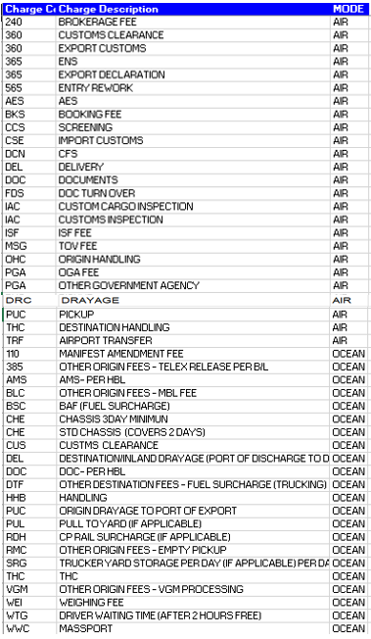
71
72
68
71 CHARGE
72 DESCRIPTION
68 REF
MGM
Management Fee Program

Slide 8
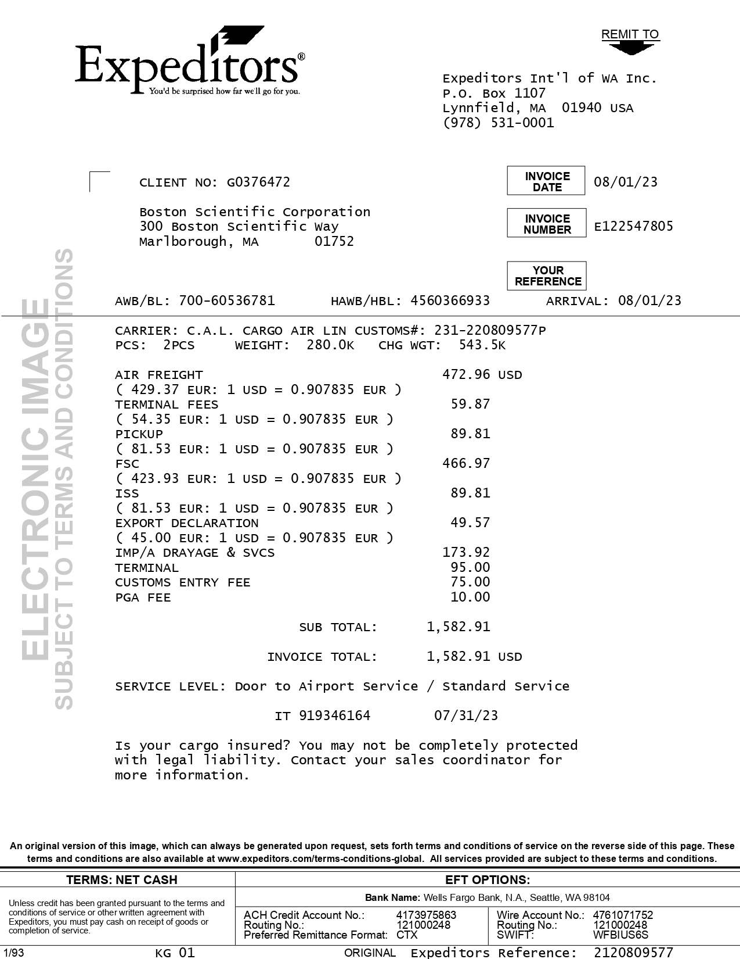
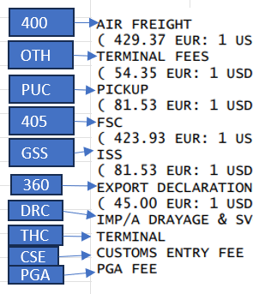
01 REMIT TO
02 BILL TO
03 INV KEY
05 ACCT
10 DATE
38 SRVC LEVEL
42 ACTUAL WT
43 FNCL WT
44/45 UOM
46 PIECES
47 TYPE
62 DELIVERED
68a AWB
68b HAWB
68c MODE
72 LINE ITEM DESC
85 LINE ITEM AMOUNT
09 CURR
08/14 INV AMT/FB AMT
01
05
02
10
68b
03
68a
42
43
62
47
46
44/45
85
NOTE:
Please see below equivalent charge codes
72
08/14
09
38
68c

Slide 9
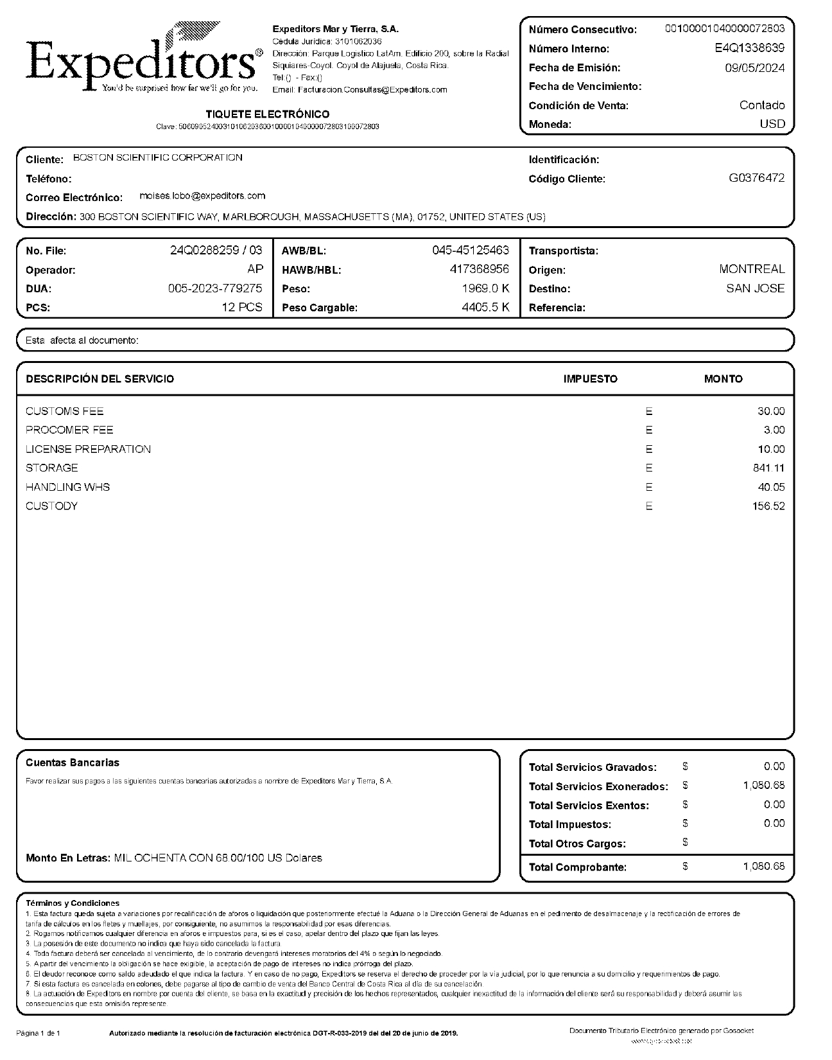
01
03
10
02
09
05
01 REMIT TO
02 BILL TO
03 INV KEY
10 DATE
09 CURR
05 ACCT
27.5 SHIPPER INV CITY
30.5 CONSIGNEE INV CITY
68a FILE NO
68b AWB
68c HAWB
46 PIECES
47 PIECES TYPE
42 ACTUAL WT
44 ACTUAL WT UOM
43 FNCL WT
45 FNCL WT U OM
72 LINE ITEM DESC
85 LINE ITEM AMT
08 INV AMT
14 FB AMT
27.5
68a
44
30.5
68b
45
46
68c
47
42
43
72
85
08/14

Slide 10
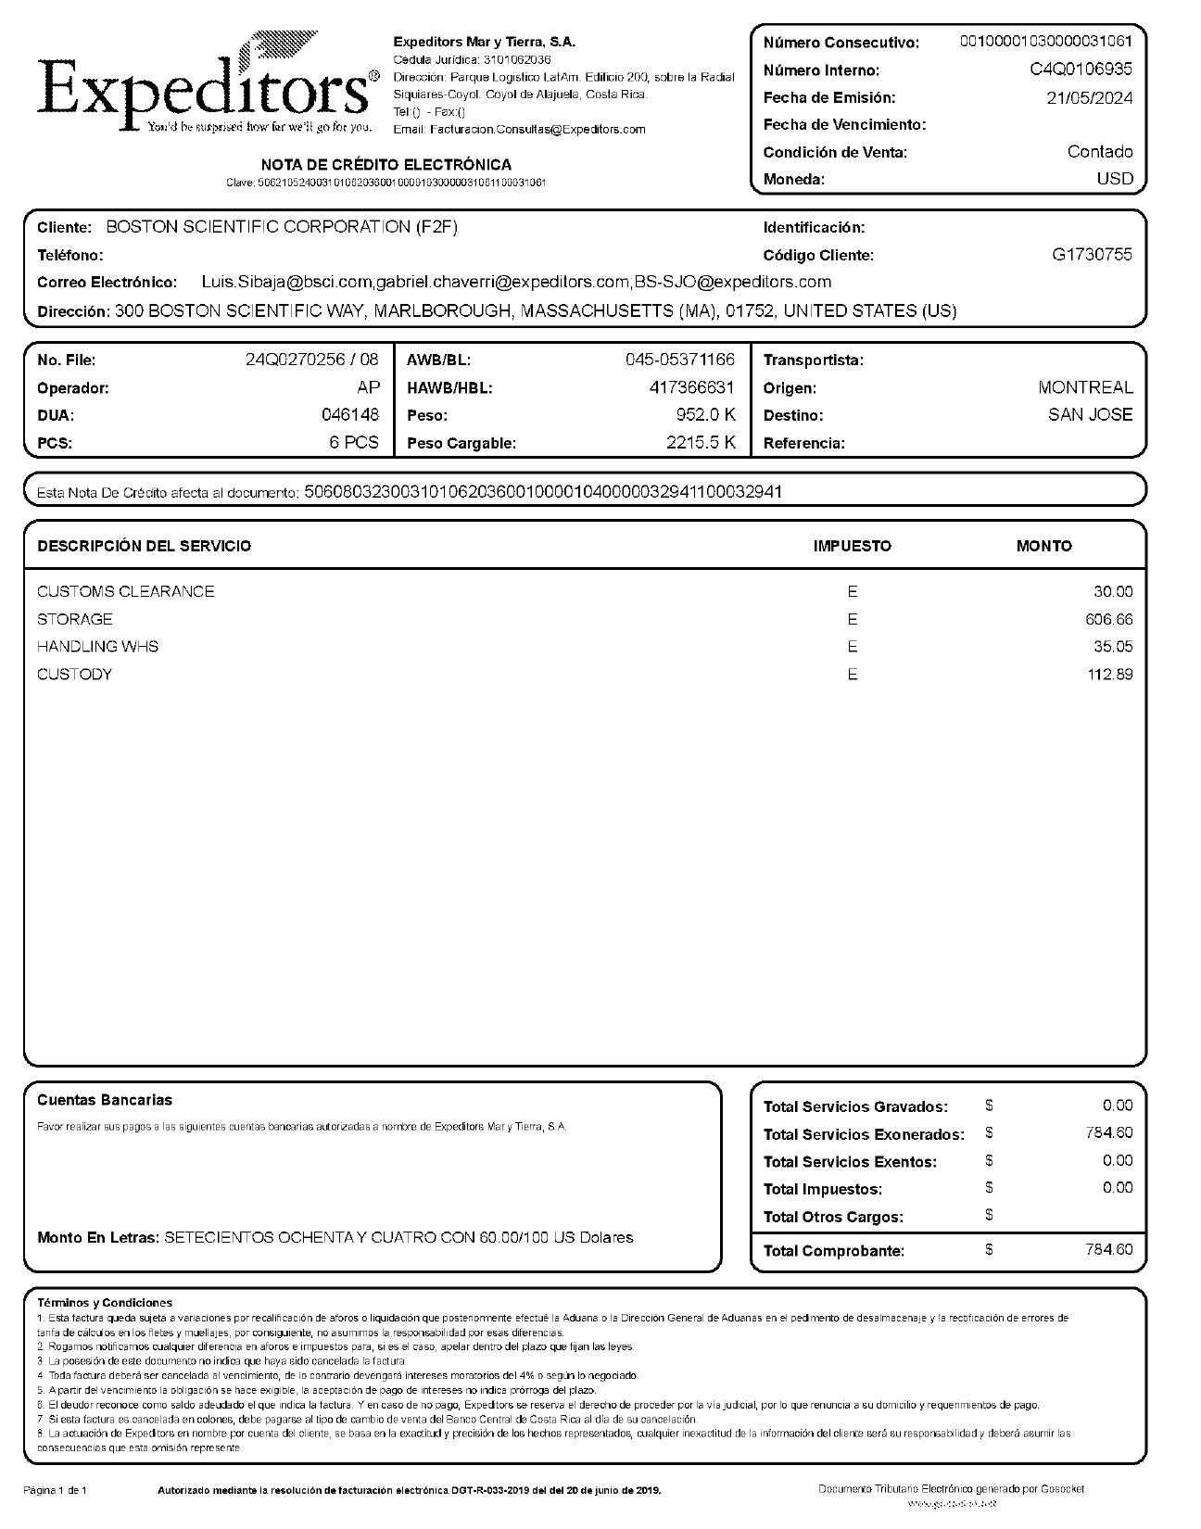
01
03
12
10
02
09
05
01 REMIT TO
02 BILL TO
03 INV KEY
10 DATE
09 CURR
05 ACCT
27.5 SHIPPER INV CITY
30.5 CONSIGNEE INV CITY
68a FILE NO
68b AWB
68c HAWB
46 PIECES
47 PIECES TYPE
42 ACTUAL WT
44 ACTUAL WT UOM
43 FNCL WT
45 FNCL WT U OM
72 LINE ITEM DESC
85 LINE ITEM AMT
08 INV AMT
14 FB AMT
12 INV INTENT
27.5
68a
44
30.5
68b
45
46
68c
47
42
43
72
85
Note: This format is CREDIT NOTE.
08/14

Slide 11
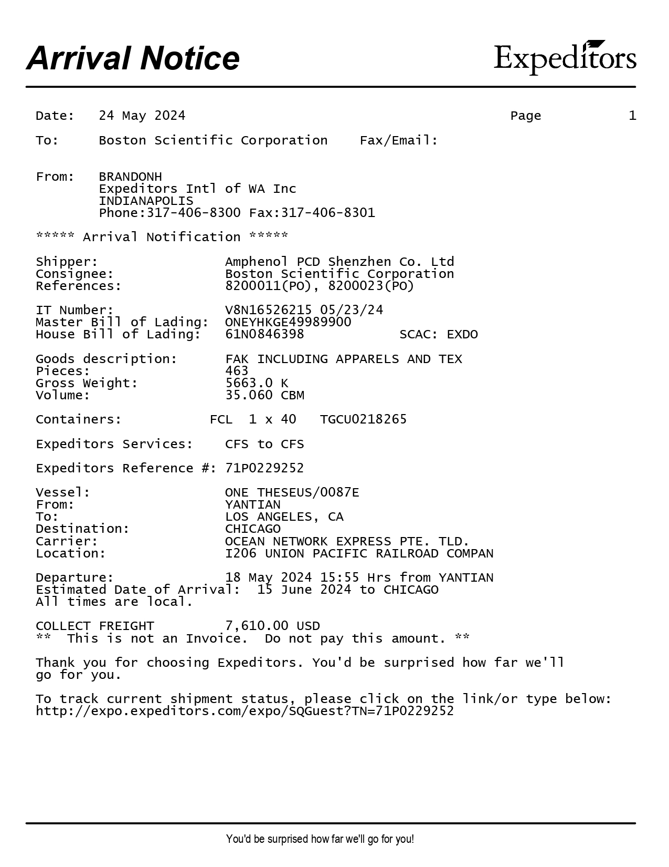
61 PICKUP
61

Slide 12
6
For Verification Table
 | NAME | DATE
DI-22580 | Marivic Ebo | 09/29/2020
DI-23511 – Updated per instruction | Reneir Tampus | 10/30/2020
DI-23773 – Replaced the charge codes | Reneir Tampus | 11/10/2020
DI-24943 – Updated per instruction | Ronald Gudito | 01/05/2021
DI-24970 – Updated per instruction to removed/recalled the request from the DI-24943 (where charge code MPF should be assigned to accessorial charge with Description "MPF Management".) | Dexie Mayls Manubag | 01/06/2021
DI-25039 – UPDATED PER INSTRUCTION | Reneir Tampus | 01/7/2021
DI-26266 – Updated per instruction | Lyn Mark Llanto | 02/25/2021
DI-26692 – Update the charge code MDM | Dexie Mayls Manubag | 3/12/2021
DI-27755 – Update the from & to information (address) priority to capture from COMMERCIAL Inv. If not provided then use BOL. | Dexie Mayls Manubag | 4/23/2021
DI-54649 – Added new invoice format and add note (slide 8) | PHILLIP L. RAMISCAL | 11/23/2023
DI-56200 – Update as per instruction (slide 5) | PHILLIP L. RAMISCAL | 1/29/2024
DI-59326 – Added new format for VALID REMIT TO (slide 9) | REGINE S. DERIADA | 5/14/2024
DI-59946 – added new slide for credit note format (slide 10) | REGINE S. DERIADA | 5/30/2024
DI-60908 – Updated as per instruction (slide 11) | JOYCE MAE CATUBIG | 6/25/2024

